Slide 1
CASHFLOW
FORECASTING
TEAM NAVIK

Slide 2


Slide 3


Slide 4


Slide 5



KEY FEATURE FOR PREDICTION
Everyday Reporting
Day of week
Past 7 Day Records
Graphical Analysis
Week of
month
Day of month
Accurate Predictions

Slide 6
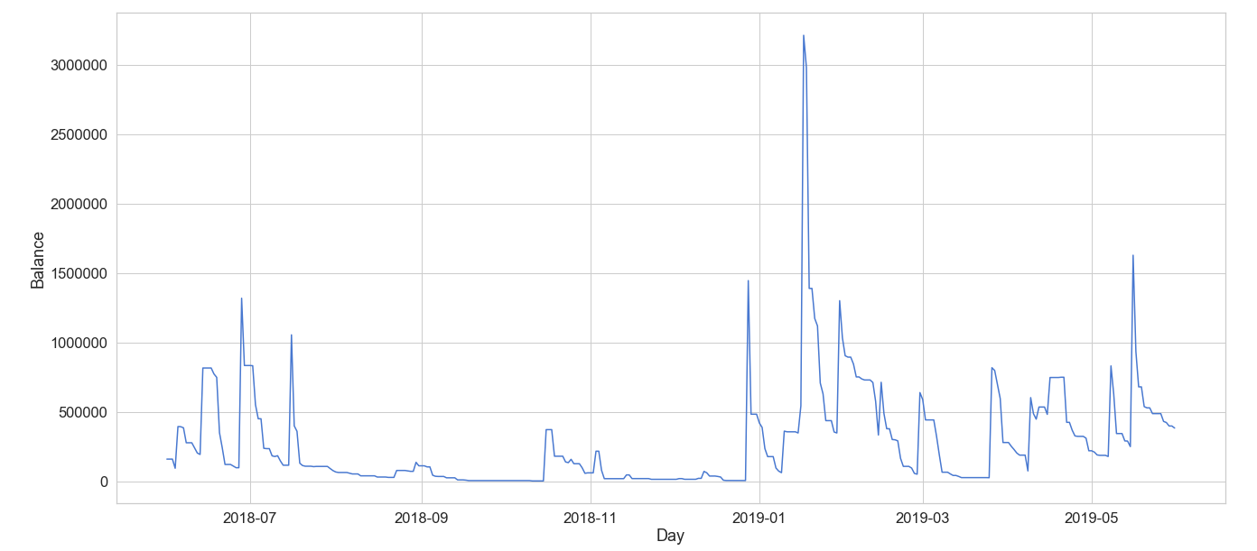
EOD Balance

Slide 7
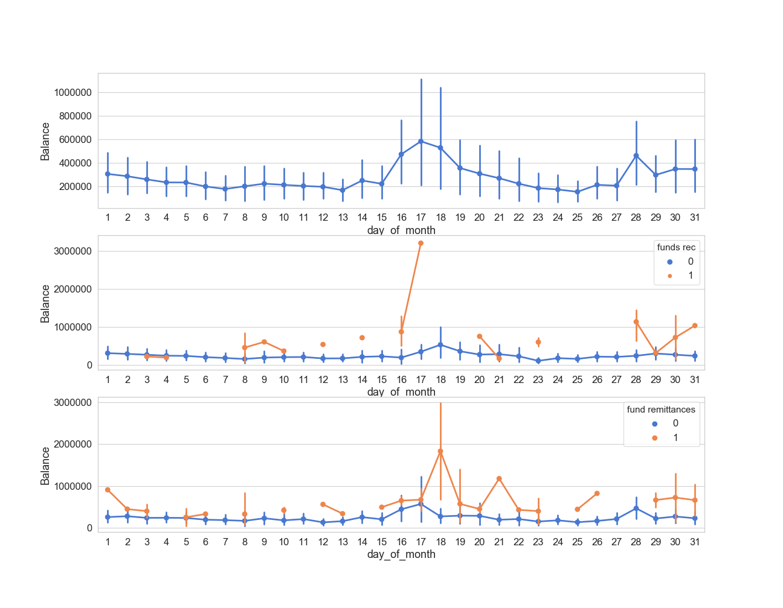
Day of month

Slide 8
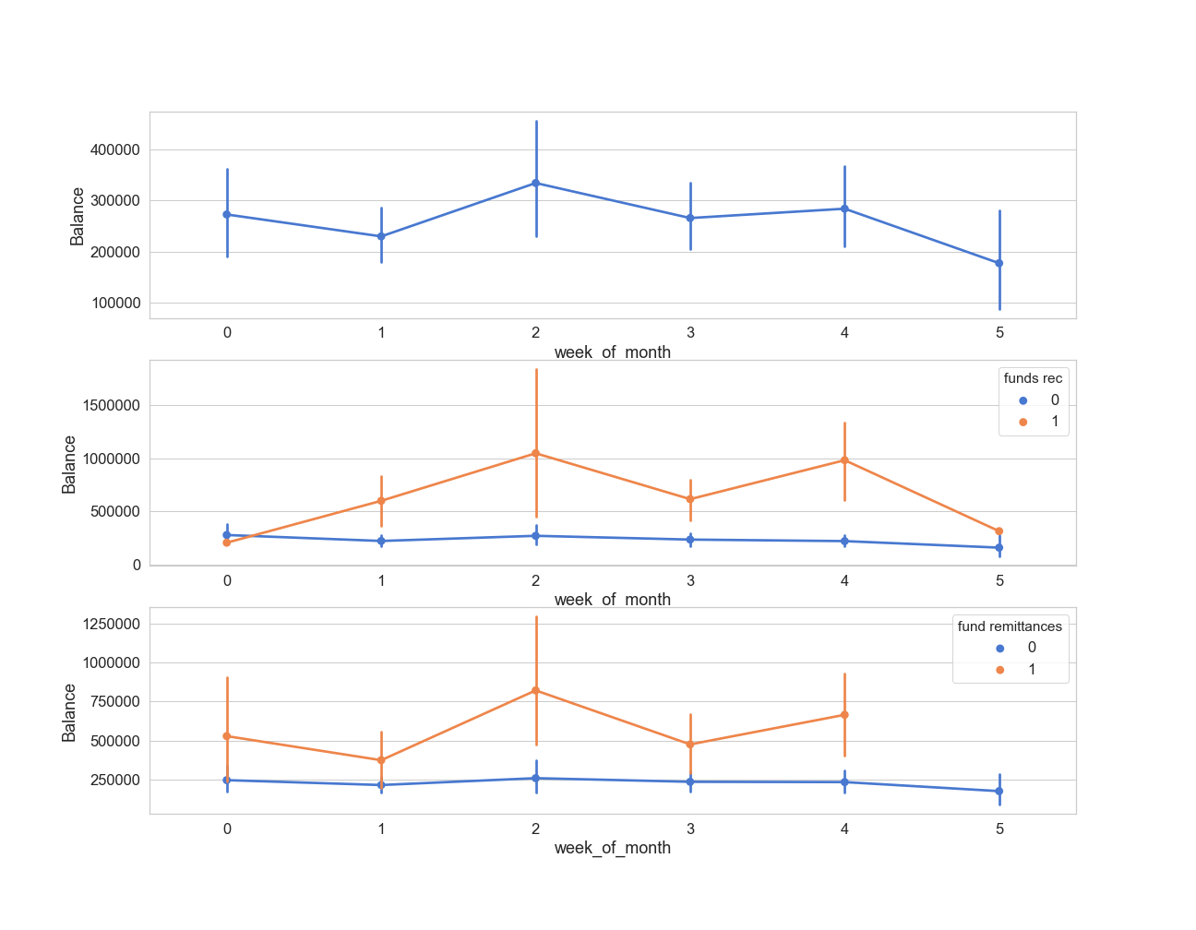
Week Of The Month
Week Of The Month

Slide 9
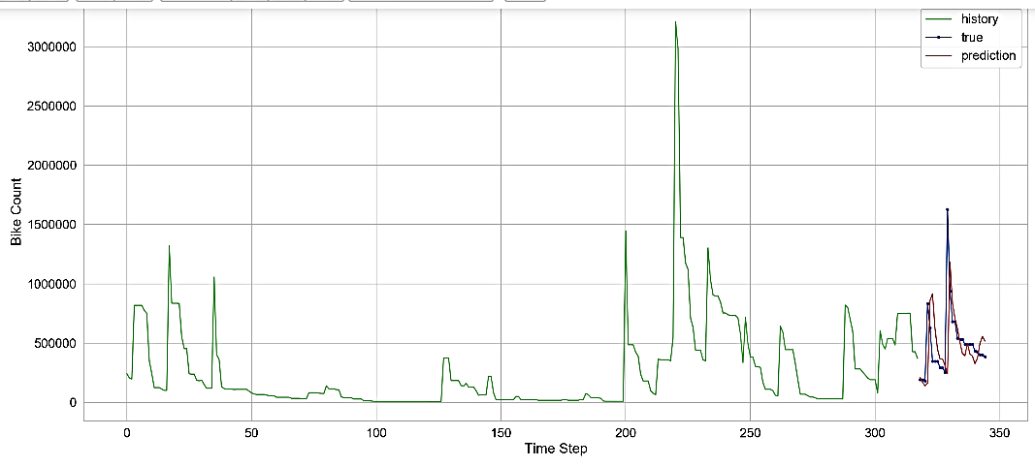
Splitting The
Data

Slide 10
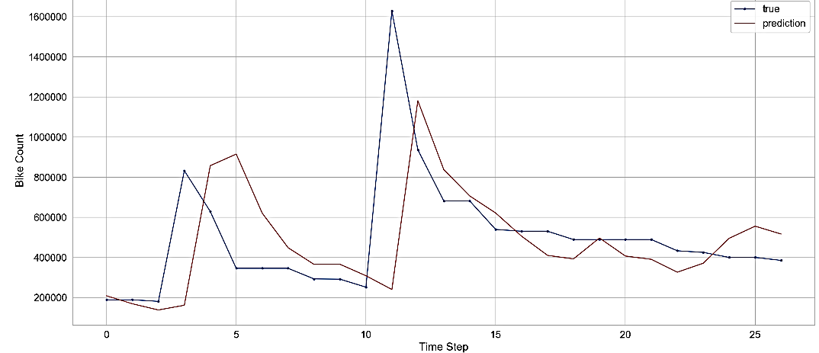

Slide 11
